Slide 1
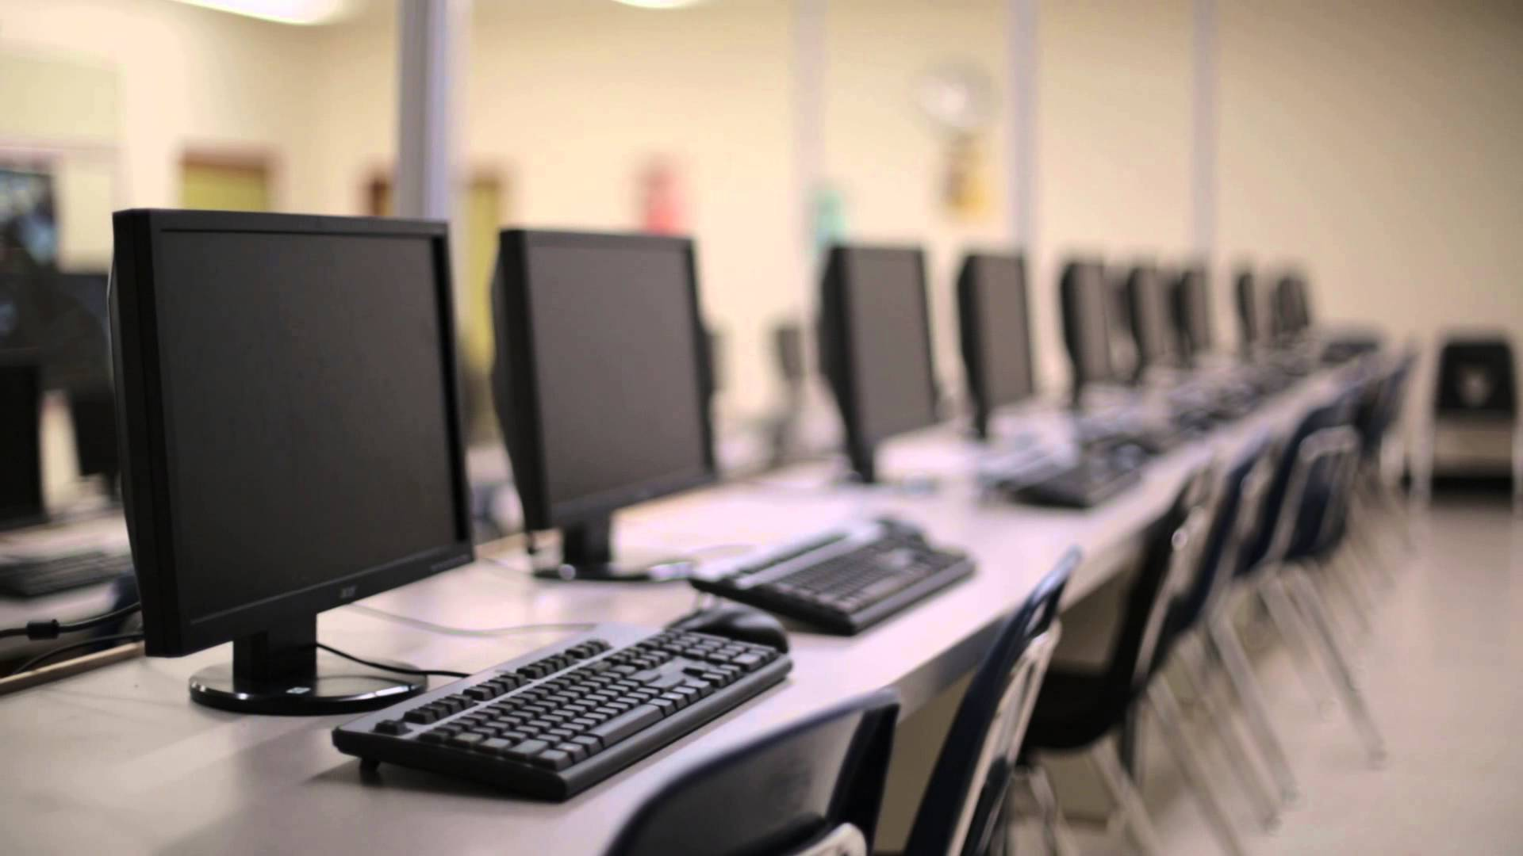
Computer Reservation System
Alex Bisbach, Levon Swenson, Junsu Jeong, Benjamin Mehn, Evan Gjerde

Slide 2
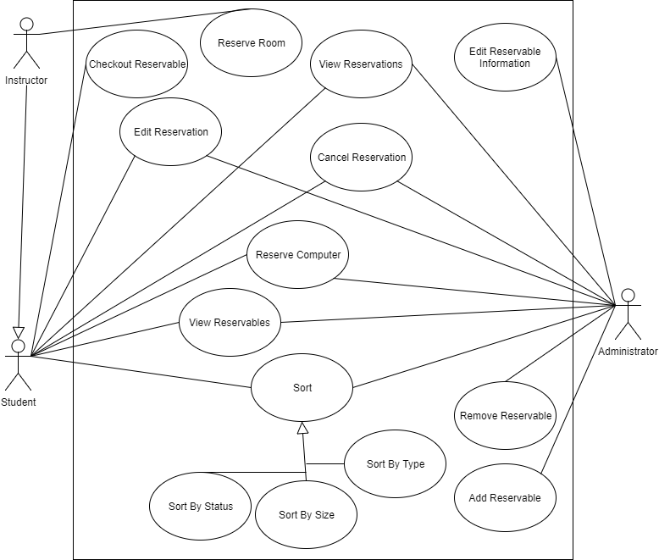
Use Case Diagram

Slide 3
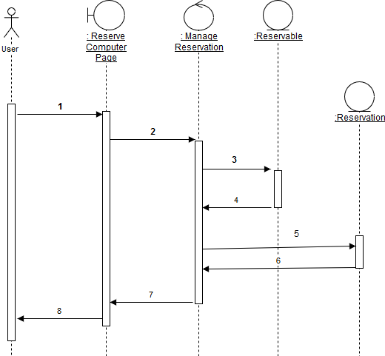
Sequence Diagram

Slide 4
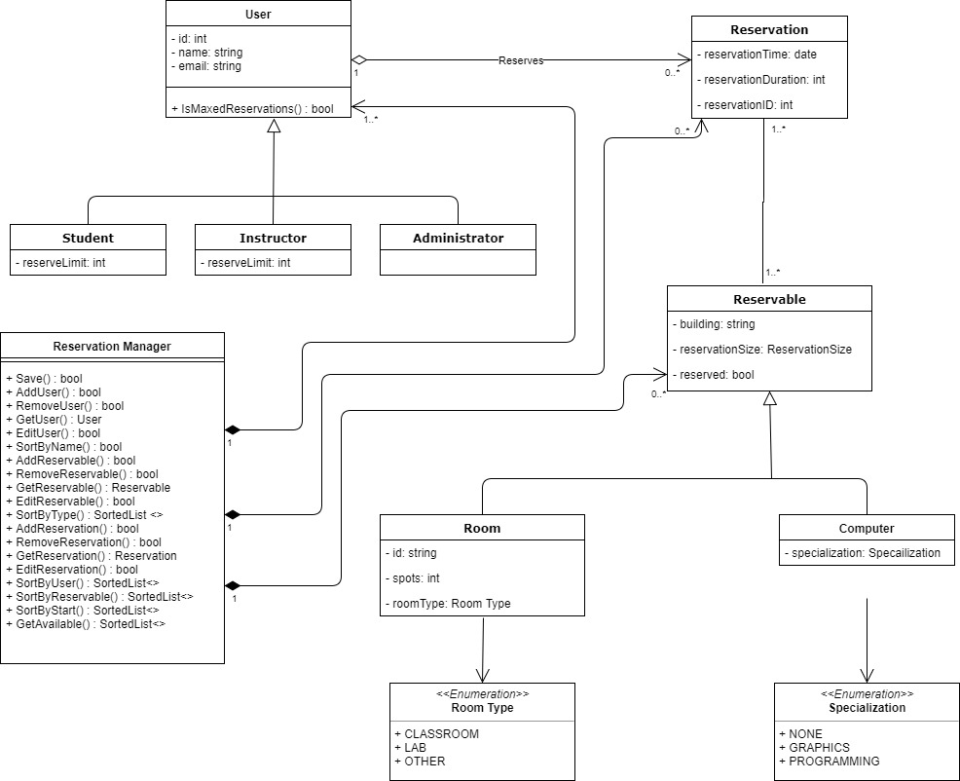
Class Diagram

Slide 5
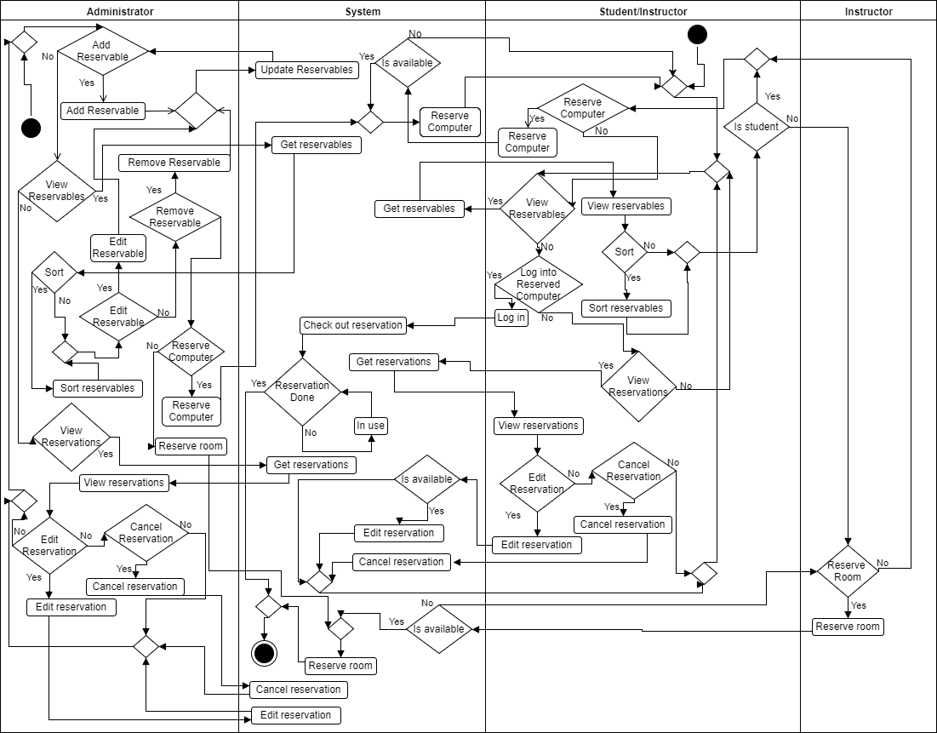
Activity Diagram

Slide 6
State Chart

Slide 7
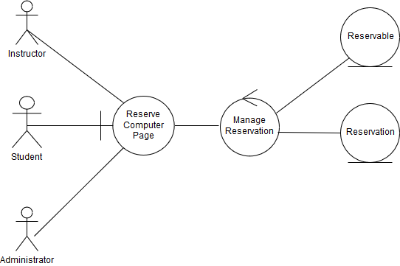
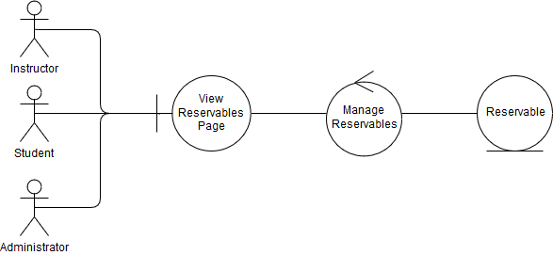
Robustness Diagrams

Slide 8
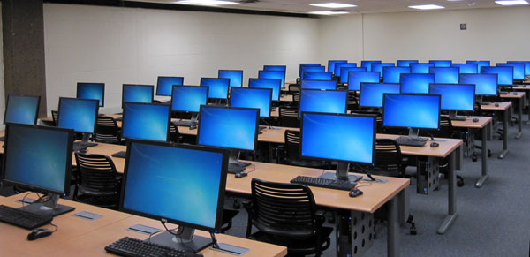
Presentation

